Slide 1
Workflow Toolkit http://toolkit.idsproject.org
Tim Bowersox
IDS Librarian
SUNY Geneseo
Notes:
[Greetings]
[Personal Introduction]
Today I’m going to talk to you about the importance of best practices
And how the Workflow Toolkit can help you adopt some of those best practices
But before I begin:
How many of you have heard of the Workflow Toolkit?
How many of you have used it in the past 3 months?
For those of you who are unfamiliar (or just curious), I will outline:
What the Workflow Toolkit is and what the future holds
How best to use it
And some of its biggest time saving best practices

Slide 2
Why adopt best practices?
You’ll get the most out of ILLiad…
Get the most for your money
Easy to customize!
Which will save your staff time…
Less time spent processing requests
More efficient workflows = fewer headaches
And save your library money…
Reduce borrowing & lending costs
Better use of staff time, equipment, & supplies
While making your users happy!
Improved turnaround time
Notes:
Why adopt best practices?
It’s simple!
[Review slide]
What it all boils down to is better and more efficient service: and who can say no to that?

Slide 3
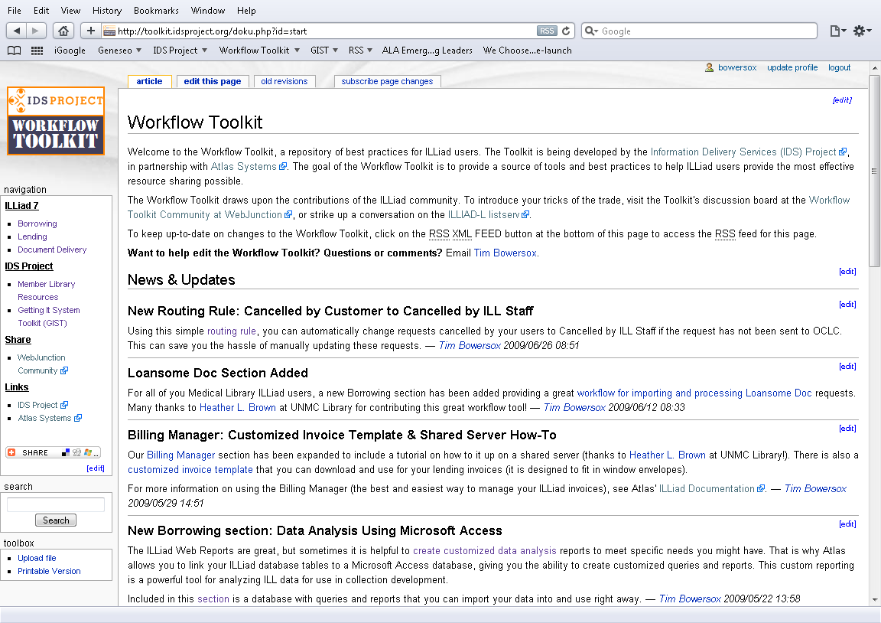
Notes:
Let’s take a brief tour of the Toolkit
This is a screen shot of the Toolkit homepage…
Pretty much your standard wiki design…
Some of the topics you’ll find in the Workflow Toolkit include
Email routings and routing rules
Custom holdings paths and groups
Word printer templates (btw, I provide links to the MS Office help sections for mail merge)
Cancellation messages
Purchasing workflows
Data analysis tips and examples using MS Access
And much more… check it out when you get a chance

Slide 4
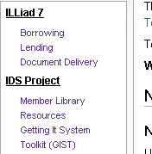
Workflow Toolkit
Organized by ILLiad workflows
Notes:
The Toolkit itself is organized by ILLiad workflows
Borrowing
Lending
Document Delivery
But it also contains a section just for staff at IDS Project Libraries
Currently houses the updated IDS custom holdings group
And our TPAM tutorial
But now also contains the documentation and downloads for GIST

Slide 5
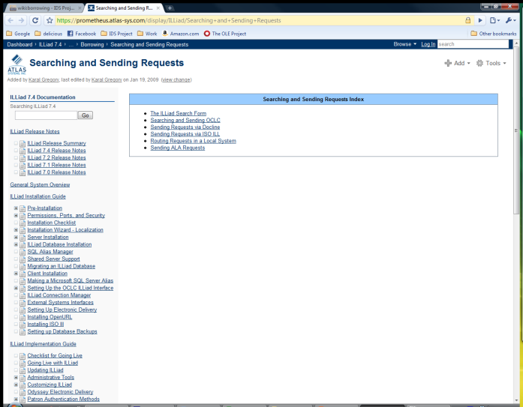
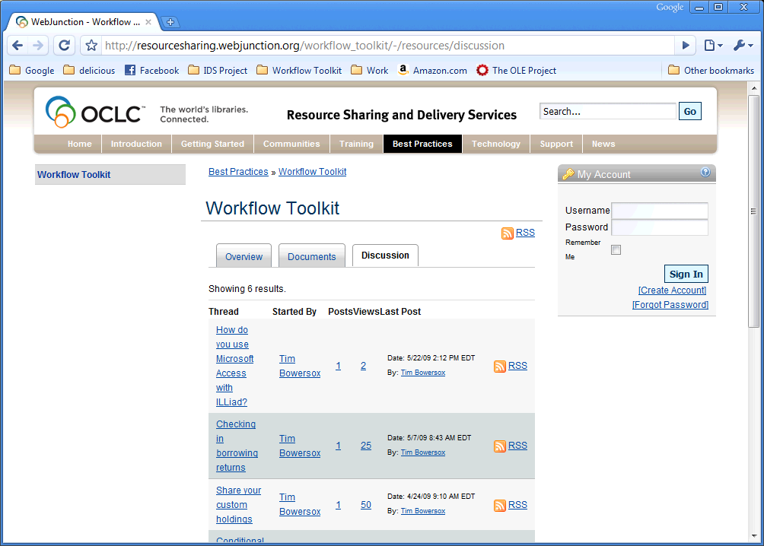
Workflow Toolkit
Links to relevant Atlas documentation, video tutorials, & WebJunction Community
Notes:
Each Workflow section is broken down into the primary steps
Each step connects you to the relevant Atlas Systems documentation & video tutorials
And then lists the Workflow Tools that apply
This allows you to learn the basics from Atlas if you’re unfamiliar with a particular step
And when you’re done, you can implement the workflow tools you want to use
Also included on each page is a link to the Toolkit’s page at WebJunction’s Resource Sharing community
Because this is a community-driven resource, the Toolkit relies on your contributions
Even if you don’t have something new to contribute, your questions & discussion are still important
That’s the only way we can make the Toolkit better for everyone

Slide 6
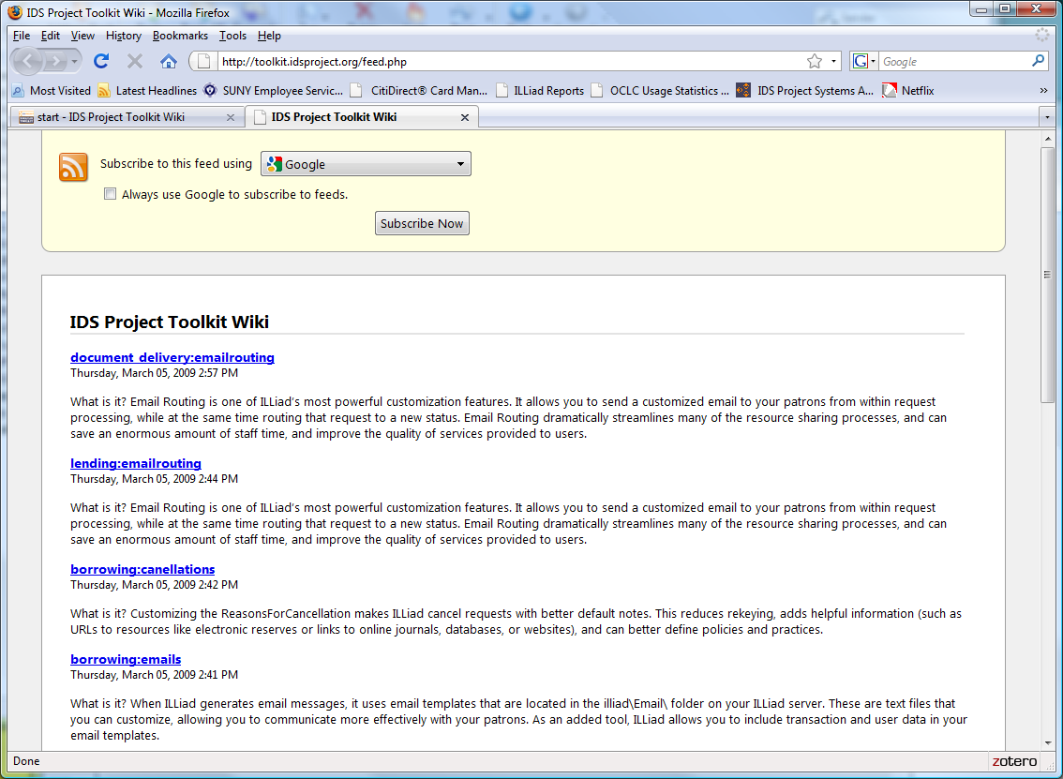
Workflow Toolkit
Syndicated updates with RSS
Notes:
One of the benefits of being a wiki is that updates to the Toolkit are now syndicated
Now you can easily find out when new tips are added or changed
To subscribe, just click on the RSS XML FEED button at the bottom of the homepage

Slide 7
Future Developments
ILLiad 8
Updating existing best practices as necessary
New features will lead to new best practices
Sharing customized layouts
Upgraded Member Library Section
Future home of the mentor modules
Central resource for documentation
Becoming core tool for mentoring
Notes:
What does the future hold for the Workflow Toolkit?
[Review Slide]

